Slide 1
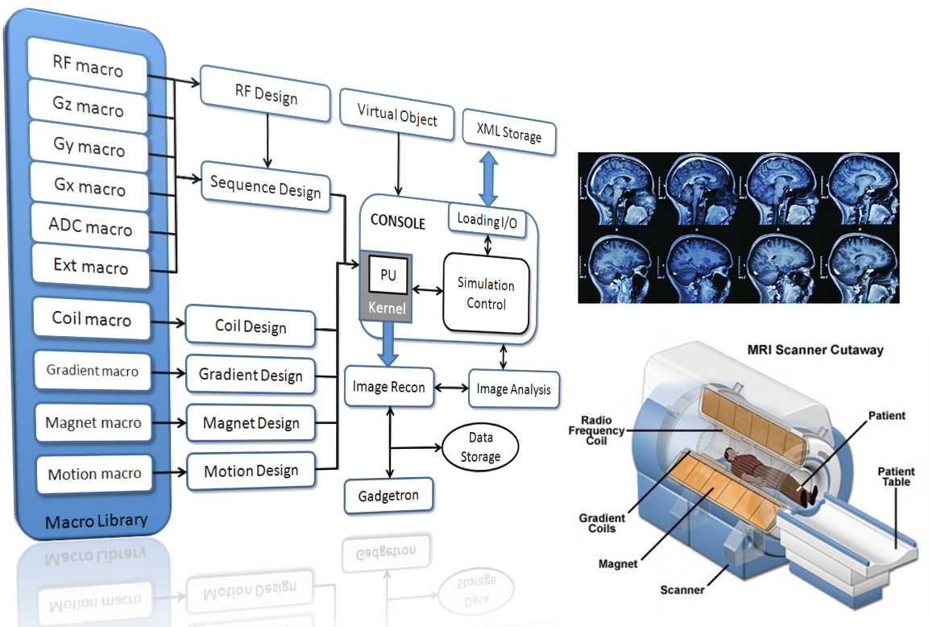

MRiLab Simulation Software Demonstration
Fang Liu, Ph.D.
Radiology, University of Wisconsin-Madison, United States
2019 ISMRM Weekend Educational Session:
Open-Source Software Tools for MR Pulse Design, Simulation & Reconstruction

Slide 2

Declaration of Financial Interests or Relationships
Speaker Name: Fang Liu
GE Healthcare equipment support

Slide 3
Table of Content
Download and Install MRiLab
Launch MRiLab
Examples
Simple GRE Simulation
Cartesian (EPI) and Non-Cartesian (radial) Acquisition
Steady-state Sequence (bSSFP)
Imaging using Multi-channel Receiving Coil
Notes:
https://youtu.be/ol3wCrbIS_4
https://youtu.be/7eVc5ztdAy4
https://youtu.be/IGl-MJcG2yg
https://youtu.be/9XRfmGKX0jY
https://youtu.be/EI3LoWrWo_o

Slide 4
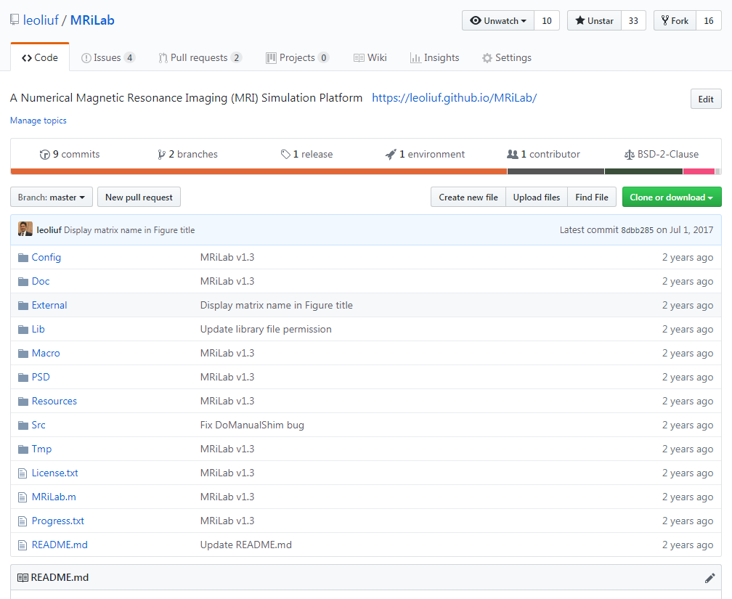
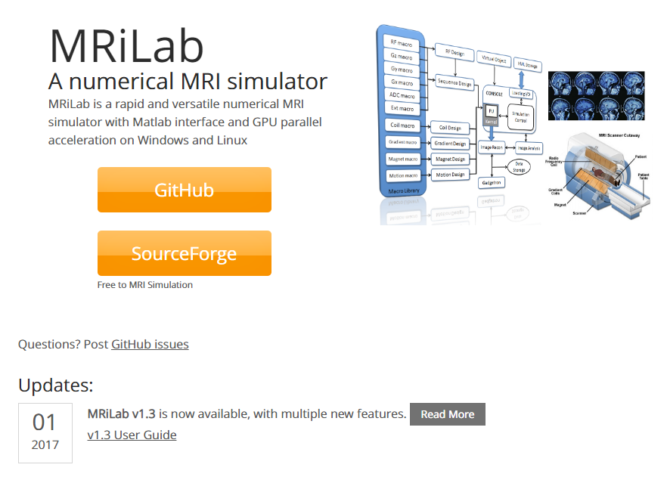
Where to Obtain MRiLab
https://leoliuf.github.io/MRiLab/
GitHub Source Code
git clone https://github.com/leoliuf/MRiLab.git

Slide 5
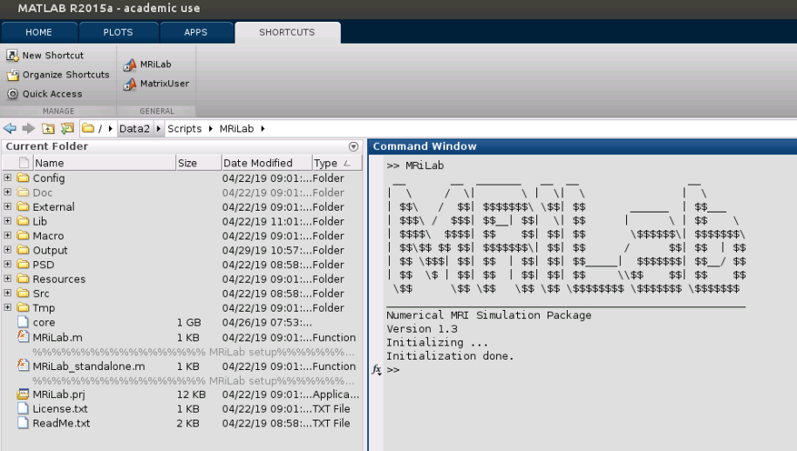
How to Launch MRiLab from Matlab
Navigate to MRiLab download folder
Run MRiLab.m in Matlab command line
MRiLab now only supports Windows and Linux OS
MRiLab needs Matlab
Nvidia GPU (optional) and Multi-core CPU
Might need recompiling some Matlab MEX files for simulation

Slide 6
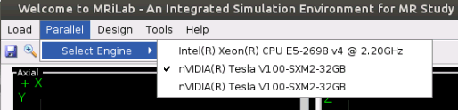
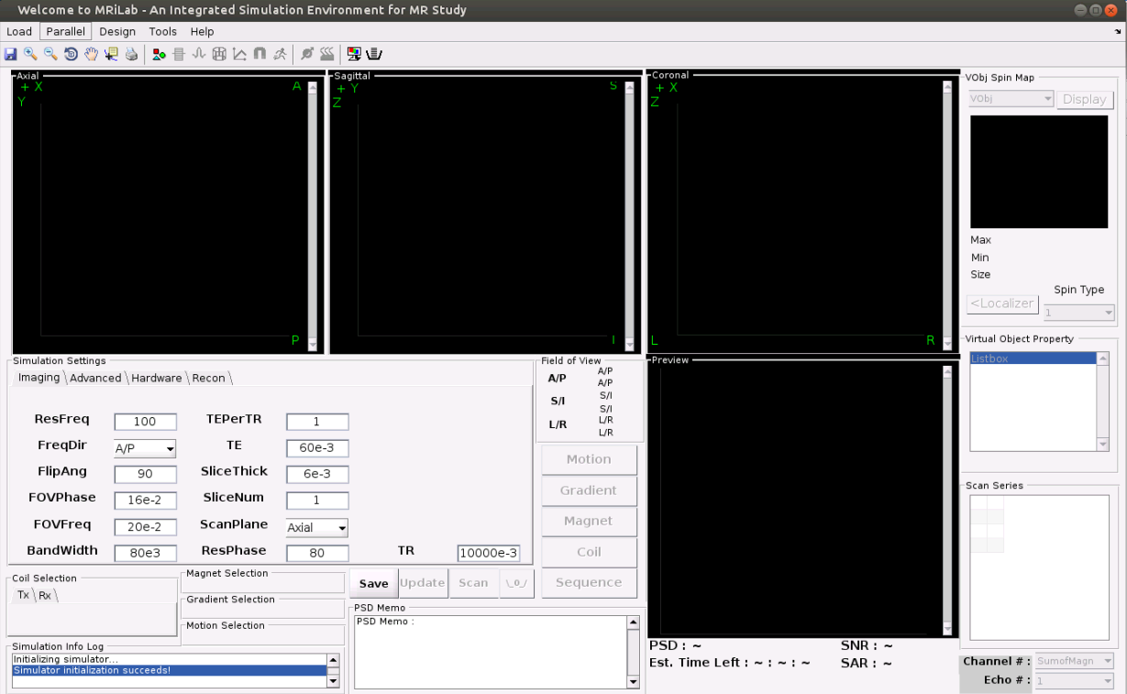
MRiLab Ready to Go !
Successful launch!
Empty main simulation console
Available simulation engines

Slide 7
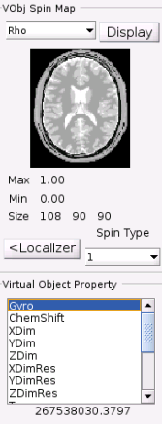
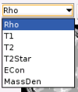
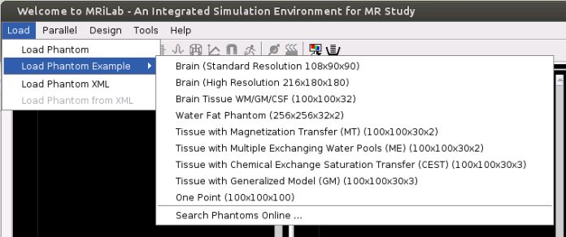
Run Simple Simulation Example
Load digital phantom
Preview phantom
Rho: spin density
T1(s): T1 relaxation time
T2(s): T2 relaxation time
T2Star(s): T2* relaxation time
Econ (S/m): Electrical conductivity
MassDen (kg/m³): mass density
etc …
Select Brain (Standard Resolution 108x90x90)
A McGill digital brain phantom simulating GM, WM, CSF, Skull tissues in the brain
https://brainweb.bic.mni.mcgill.ca/brainweb/

Slide 8
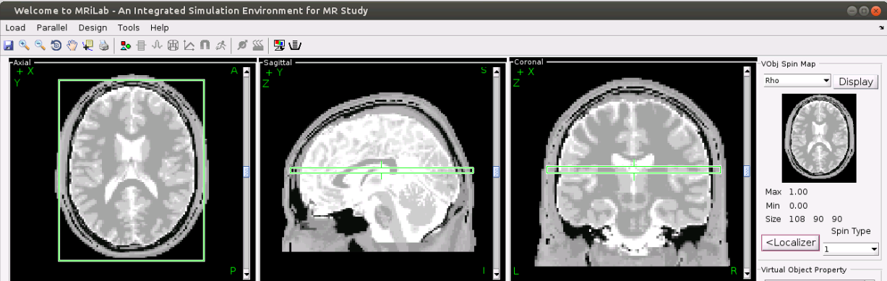
Run Simple Simulation Example
Use digital phantom as a Localizer
Exam the anatomy of the digital phantom in three-dimensional space (i.e., Axial, Sagittal and Coronal slices)
Use scroll bar to navigate through different slices
Green box is the acquisition field-of-review

Slide 9
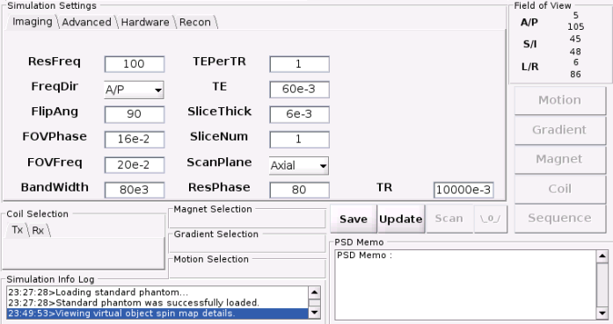
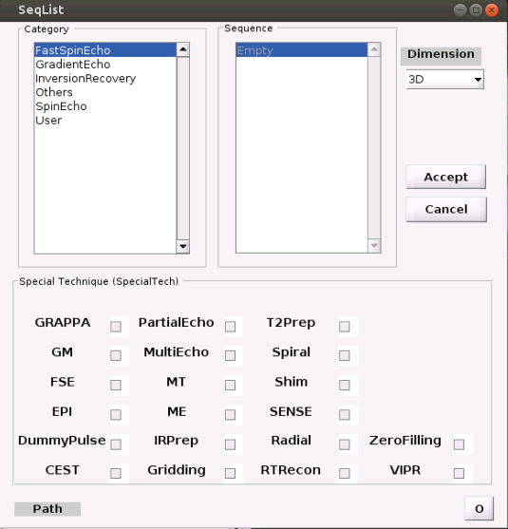
Run Simple Simulation Example
Press ‘Update’ to confirm digital phantom and activate module selection functions
Press ‘Sequence’ to open MR sequence library
Load a MR sequence for the simulation
1
2

Slide 10
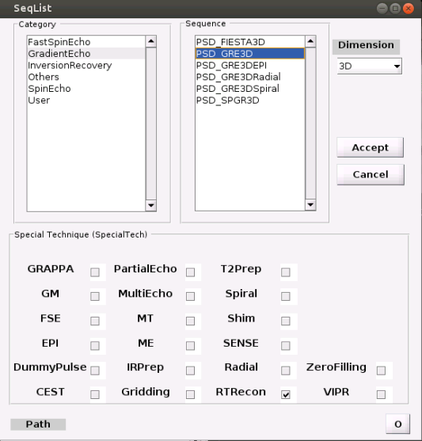
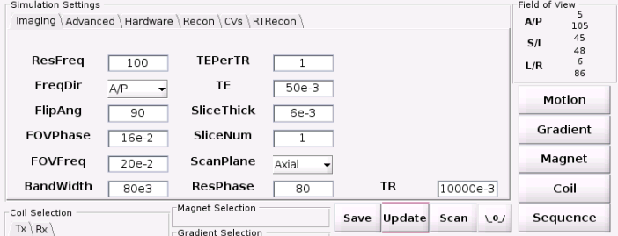
Run Simple Simulation Example
Select a basic 3D Gradient Echo (GRE) sequence
Click ‘GradientEcho’-> ‘PSD_GRE3D’, then press ‘Accept’
Press ‘Update’ to confirm sequence selection

Slide 11
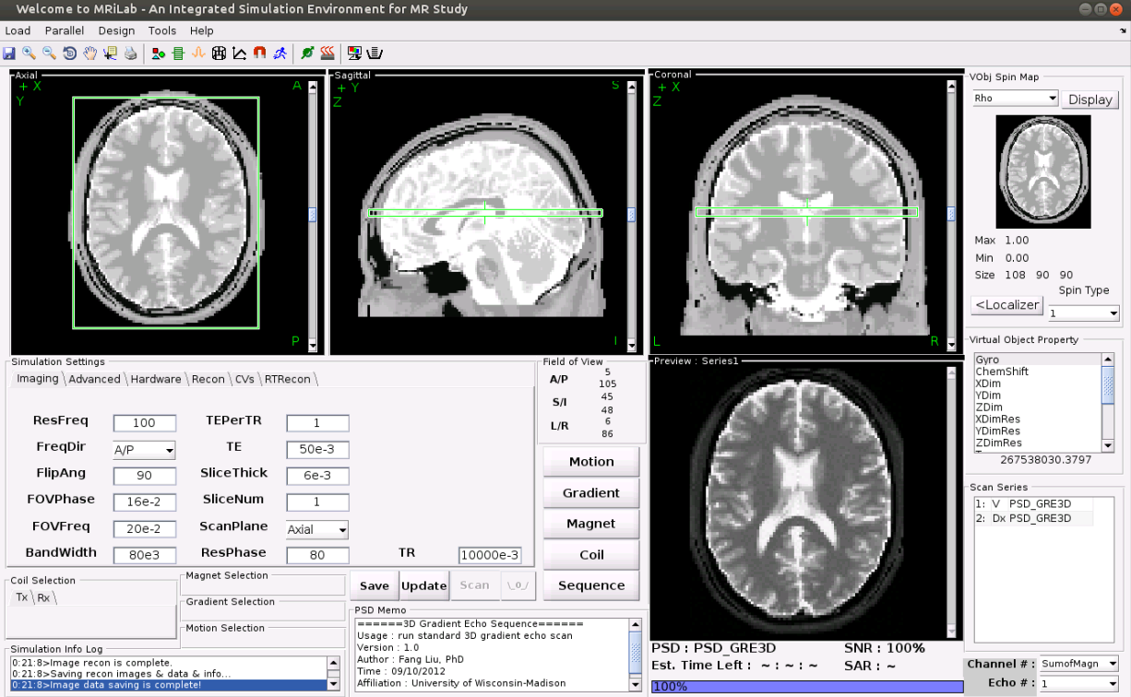
Run Simple Simulation Example
Now leave it as it is and click ‘Scan’
The result shows in a few seconds with GPU or a few minutes with CPU
Inspect simulated image at the preview window
In this example, you will get a single slice image with gradient echo contrast for the central axial slice of the brain
Congrats!

Slide 12
Run Simple Simulation Example (Video Demo)
https://youtu.be/ol3wCrbIS_4

Slide 13
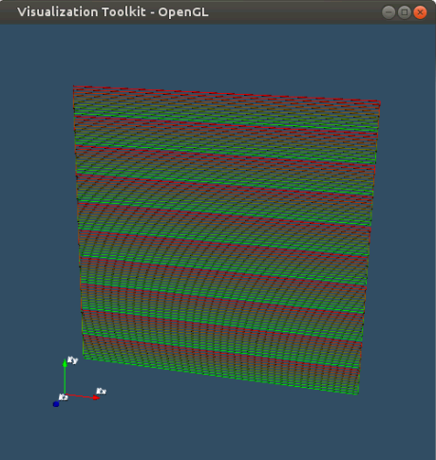
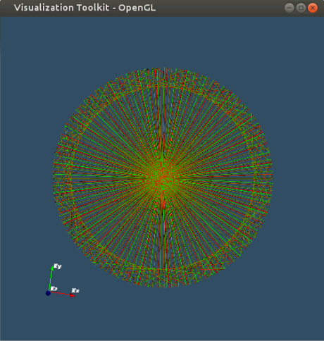
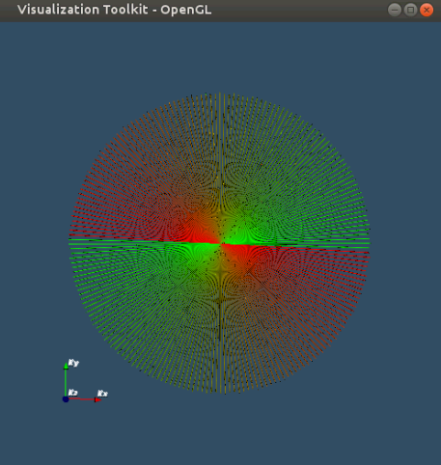
Cartesian vs. Non-Cartesian
Multi-shot
Echo-Planar Imaging (EPI)
Radial Imaging
Golden-angle
Linear

Slide 14
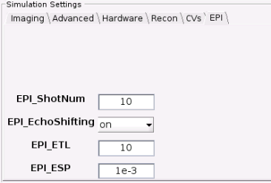
Echo-Planar Imaging (EPI)
Load digital phantom Brain (Standard Resolution 108x90x90)
Select a basic 3D Gradient Echo (GRE) sequence
Click ‘Scan’ to perform simulation
Click ‘GradientEcho’-> ‘PSD_GRE3DEPI’, then press ‘Accept’
Press ‘Update’ to confirm sequence selection
EPI tab
EPI_ESP(s): the echo spacing for EPI
EPI_ETL: the echo train length for EPI
EPI_ShotNum: the # of EPI shots for multi-shot EPI
EPI_EchoShifting: the flag for control echo shifting

Slide 15
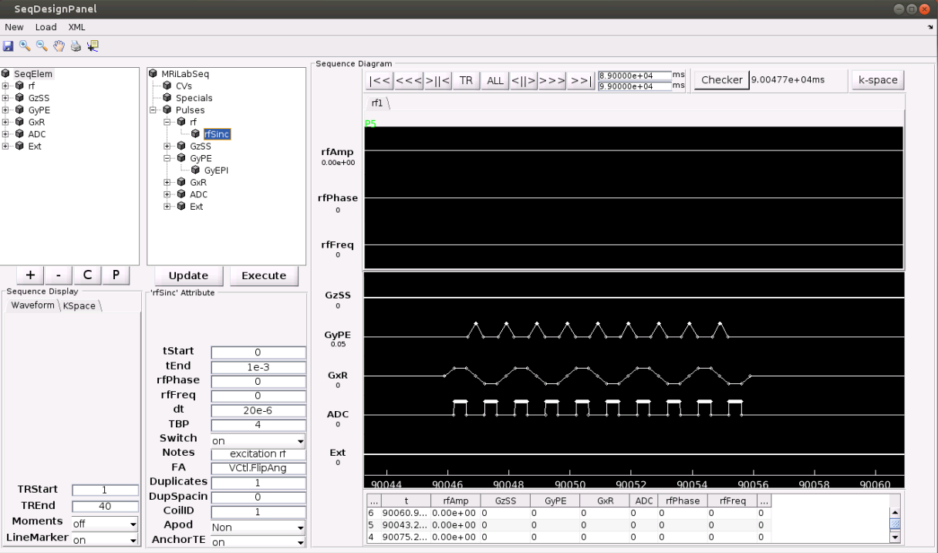
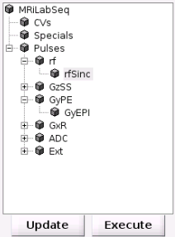
Echo-Planar Imaging (EPI)
Sequence Tree and Gradient Waveform

Slide 16
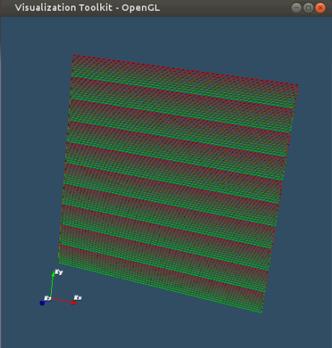
Echo-Planar Imaging (EPI)
K-space Trajectory

Slide 17
Echo-Planar Imaging (Video Demo)
https://youtu.be/7eVc5ztdAy4

Slide 18
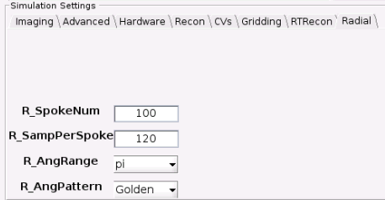
Radial Imaging
Select a basic 3D Gradient Echo (GRE) sequence
Click ‘Scan’ to perform simulation
Click ‘GradientEcho’-> ‘PSD_GRE3DRadial’, then press ‘Accept’
Press ‘Update’ to confirm sequence selection
Radial tab
R_SpokeNum: the # of sampling spokes
R_SampPerSpoke: the # of sampling points in each spoke
R_AngRange: the range of sampling angle
R_AngPattern: the pattern for sampling the angle
(Linear vs. Golden-Angle)

Slide 19
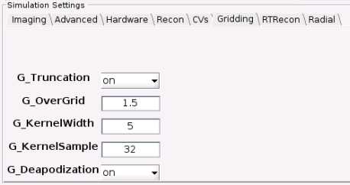
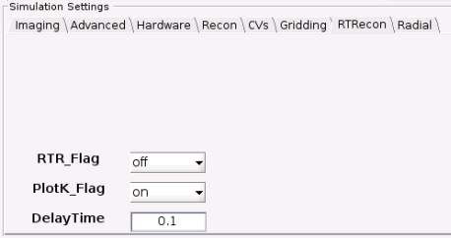
Radial Imaging
Gridding tab
MRiLab uses Voronoi diagram for k-space density compensation, and uses Kaiser-Bessel kernel for gridding
G_KernelSample : the # of kernel sample point
G_KernelWidth : the full width of gridding kernel
G_OverGrid : the over gridding factor
G_Deapodization : the flag to control kernel deapodization
G_Truncation : the flag to control image truncation for reconstructed image
Real-time Recon tab
RTR_Flag : the flag to control real time reconstruction
PlotK_Flag : the flag to control real time k-space plotting
DelayTime : the delay time for refreshing graphics
Notes:
[2] J.I. Jackson, C.H. Meyer, D.G. Nishimura, and A. Macovski: Selection of a Convolution Function for Fourier Inversion Using Gridding , IEEE Trans. Med. Imag., 10, (1991), 473-478.
[3] V. Rasche, R. Proska, R. Sinkus, P. Boernert, and H. Eggers: Resampling of Data Between Arbitrary Grids Using Convolution Interpolation , IEEE Trans. Med. Imag., 18, (1999), 385-392.
[4] P.J. Beatty, D.G. Nishimura, and J.M. Pauly: Rapid gridding reconstruction with a minimal oversampling ratio , IEEE Trans. Med. Imag., 24, (2005), 799-808.

Slide 20
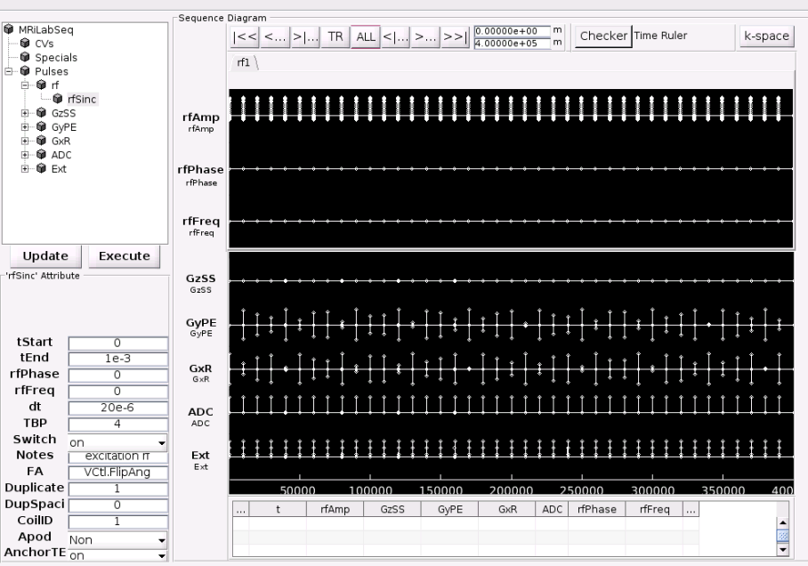
Radial Imaging
Sequence Tree and Gradient Waveform
(Multiple TRs)
Golden
Angle
Linear
Angle

Slide 21
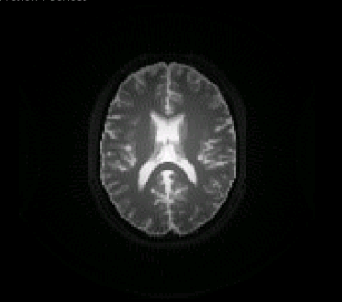
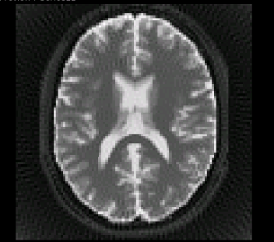
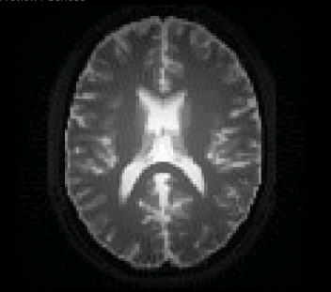
Radial Imaging
1.5 over gridding
With image truncation
With kernel deapodization
1.5 over gridding
No image truncation
No kernel deapodization
1.5 over gridding
With image truncation
No kernel deapodization

Slide 22
Radial Imaging (Video Demo)
https://youtu.be/IGl-MJcG2yg

Slide 23
Steady-state Sequence (bSSFP)
Select a basic 3D Gradient Echo (GRE) sequence
Click ‘Scan’ to perform simulation
Click ‘GradientEcho’-> ‘PSD_FIESTA3D’, then press ‘Accept’
Press ‘Update’ to confirm sequence selection
Steady-state free precession
Fast imaging employing steady-state acquisition (FIESTA, GE)
True Fast imaging with steady-state precession (TrueFISP, Simens)
Balanced Fast Field Echo (b-FFE, Philips)
Short TR with gradient refocusing
Less vulnerable to T2* effects than GRE sequence
Greater contrast-to-noise and signal-to-noise ratios

Slide 24
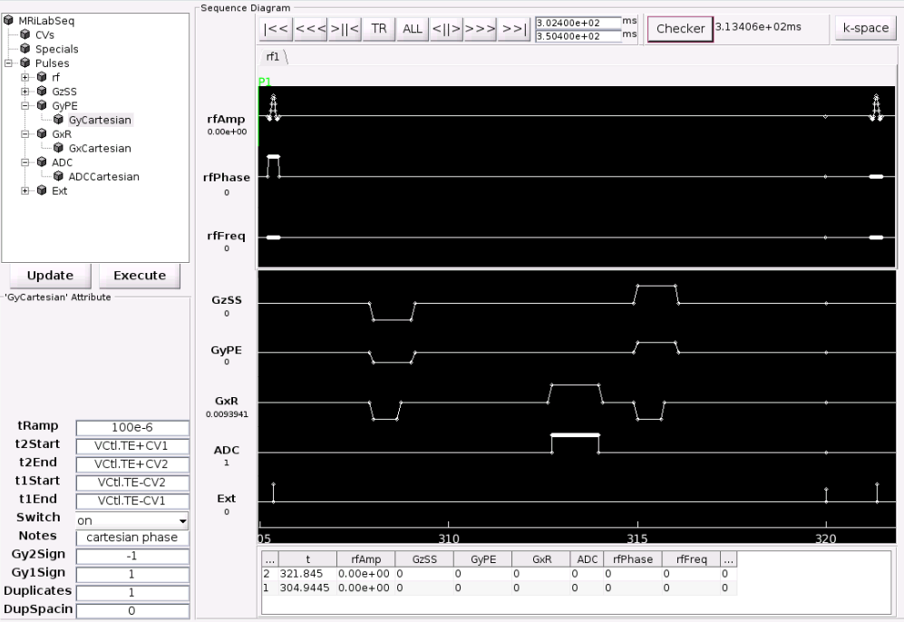
Steady-state Sequence (bSSFP)
rf phase cycling
Readout
Rewinder Gradient
Gradient

Slide 25
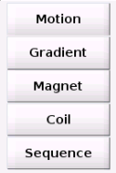
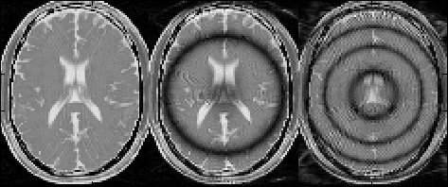
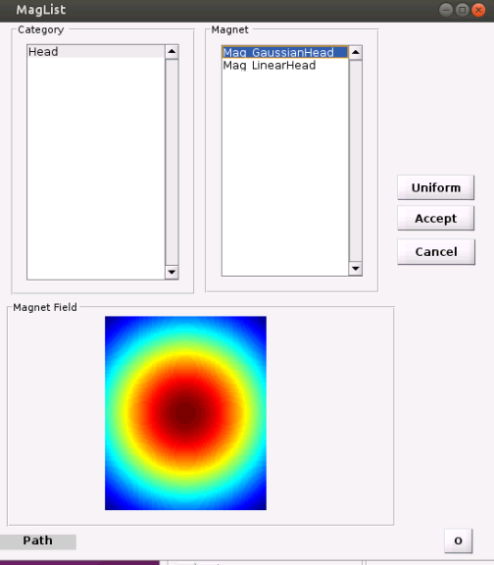
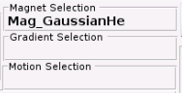
Steady-state Sequence (bSSFP)
Non-uniform B0
Load a field profile for the simulation
Uniform B0 (default)
Click ‘Head’-> ‘Mag_GaussianHead’, then press ‘Accept’
Loaded field profile
TR/TE = 16/8ms
FA = 20°

Slide 26
Steady-state Sequence (bSSFP)
Uniform B0 (default)
Non-uniform B0
TR/TE = 16/8ms
FA = 20°
TR/TE = 16/8ms
FA = 20°
Gaussian B0
TR/TE = 32/16ms
FA = 20°
Gaussian B0

Slide 27
Steady-state Sequence (Video Demo)
https://youtu.be/9XRfmGKX0jY

Slide 28
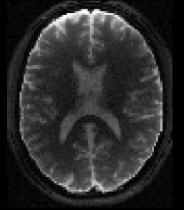
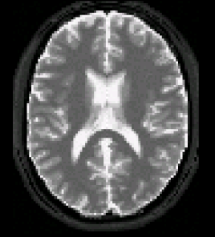
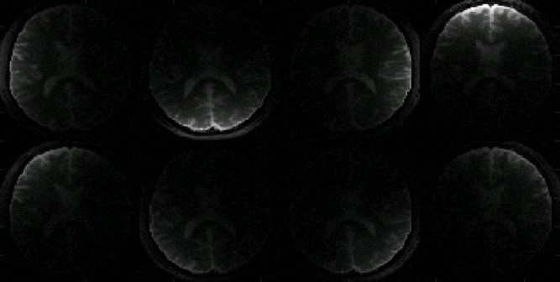
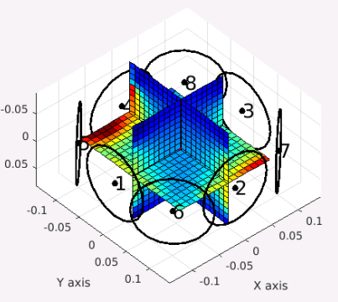
Multi-channel Receiving
Realistic B1 (8-channel)
Ideal B1 (default)

Slide 29
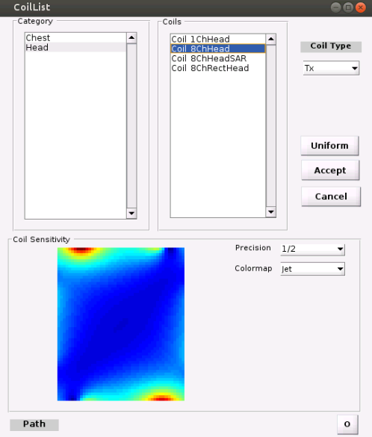
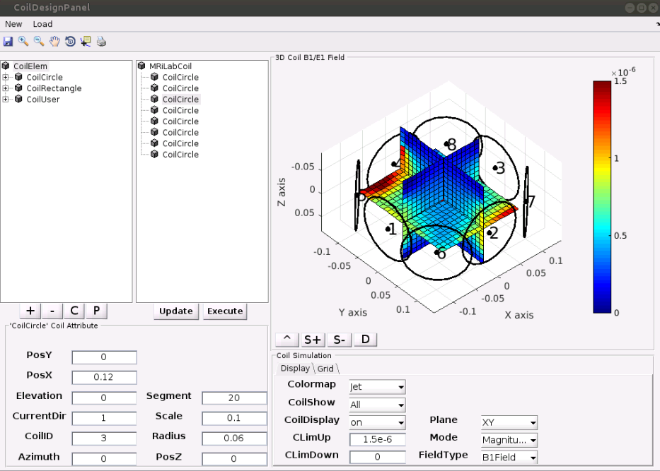
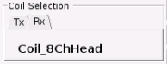
Multi-channel Receiving
Load PSD_3DGRE sequence
Load a coil profile for the simulation
Coil configuration
Click ‘Head’-> ‘Coil_8ChHead’, select ‘Rx’, then press ‘Accept’
Loaded Rx coil profile

Slide 30
Multi-channel Receiving (Video Demo)
https://youtu.be/EI3LoWrWo_o

Slide 31
THANK YOU
Open-source
https://leoliuf.github.io/MRiLab/
User guide
MRI Simulator
https://leoliuf.github.io/MRiLab/manual/
MRiLab_User_Guide_v1_3/
MRiLab_User_Guide.html
More demo
Ask me for them ☺
leoliuf@gmail.com

